Slide 1
Chapter 3 - Data Modeling Using the Entity– Relationship (ER) Model

Slide 2
- Using High-Level Conceptual Data Models for Database Design - A Sample Database Application - Entity Types, Entity Sets, Attributes and Keys - Relationship Types, Relationship Sets, Roles, and Structural Constraints - Weak Entity Types - Refining the ER Design for the COMPANY Database - ER Diagrams, Naming Conventions, and Design Issues -Relationship Types of Degree Higher than Two
Content

Slide 3
Refining the ER Design for the COMPANY Database
In our example, we specify the following relationship types:
■ MANAGES, which is a 1:1(one-to-one) relationship type between EMPLOYE and DEPARTMENT. EMPLOYEE participation is partial. The attribute Start_date is assigned to this relationship type.
■ WORKS_FOR, a 1:N (one-to-many) relationship type between DEPARTMENT and EMPLOYEE. Both participations are total.
■ CONTROLS, a 1:N relationship type between DEPARTMENT and PROJECT. The participation of PROJECT is total, whereas that of DEPARTMENT is determined to be partial, after consultation with the users indicates that some departments may control no projects.

Slide 4
Refining the ER Design for the COMPANY Database
In our example, we specify the following relationship types:
■ SUPERVISION, a 1:N relationship type between EMPLOYEE (in the supervisor role) and EMPLOYEE (in the supervisee role). Both participations are determined to be partial, after the users indicate that not every employee is a supervisor and not every employee has a supervisor.
■ WORKS_ON, determined to be an M:N (many-to-many) relationship type with attribute Hours, after the users indicate that a project can have several employees working on it. Both participations are determined to be total.
■ DEPENDENTS_OF, a 1:N relationship type between EMPLOYEE and DEPENDENT, which is also the identifying relationship for the weak entity type DEPENDENT. The participation of EMPLOYEE is partial, whereas that of DEPENDENT is total.

Slide 5
ER Diagrams, Naming Conventions, and Design Issues
Summary of Notation for ER Diagrams
In ER diagrams the emphasis is on representing the schemas rather than the instances.
This is more useful in database design because a database schema changes rarely, whereas the contents of the entity sets may change frequently.
In addition, the schema is obviously easier to display, because it is much smaller.

Slide 6
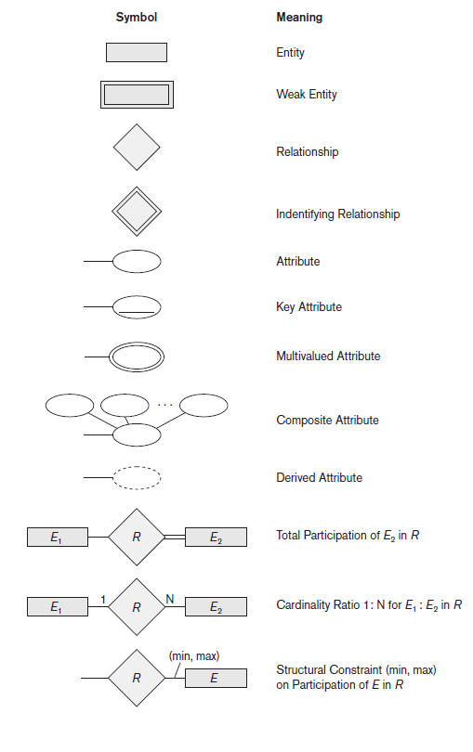
ER Diagrams, Naming Conventions, and Design Issues
Summary of Notation for ER Diagrams

Slide 7
ER Diagrams, Naming Conventions, and Design Issues
Proper Naming of Schema Constructs
Choose names that convey, as much as possible.
Use singular names for entity types, rather than plural ones, because the entity type name applies to each individual entity belonging to that entity type.
Entity type and relationship type names are in uppercase letters,
Attribute names have their initial letter capitalized,
and role names are in lowercase letters.

Slide 8
A Sample Database Application
The company is organized into departments. Each department has a unique name, a unique number, and a particular employee who manages the department. We keep track of the start date when that employee began managing the department. A department may have several locations.
A department controls a number of projects, each of which has a unique name, a unique number, and a single location.
The database will store each employee’s name, Social Security number,address, salary, sex (gender), and birth date. An employee is assigned to one department, but may work on several projects, which are not necessarily controlled by the same department. It is required to keep track of the current number of hours per week that an employee works on each project, as well as the direct supervisor of each employee (who is another employee).
The database will keep track of the dependents of each employee for insurance purposes, including each dependent’s first name, sex, birth date, and relationship to the employee.

Slide 9
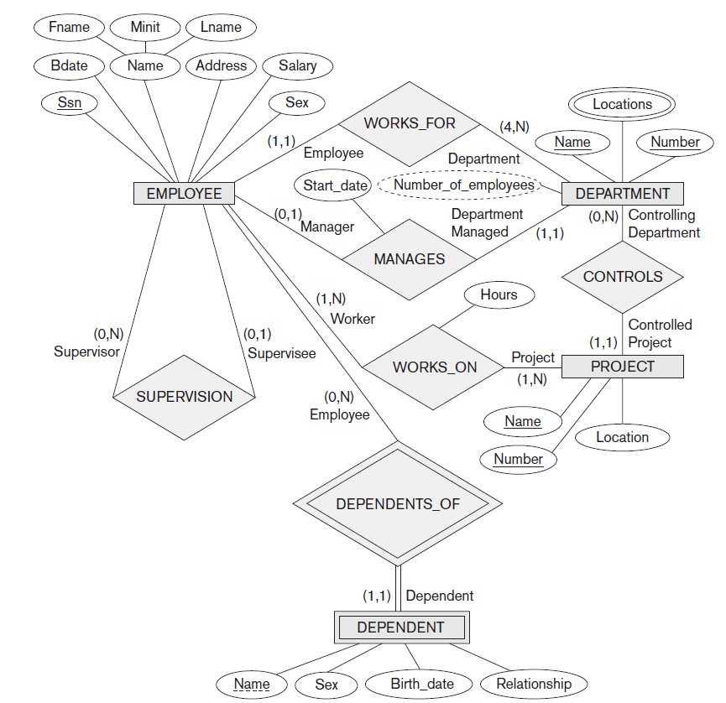
ER Diagrams, Naming Conventions, and Design Issues

Slide 10
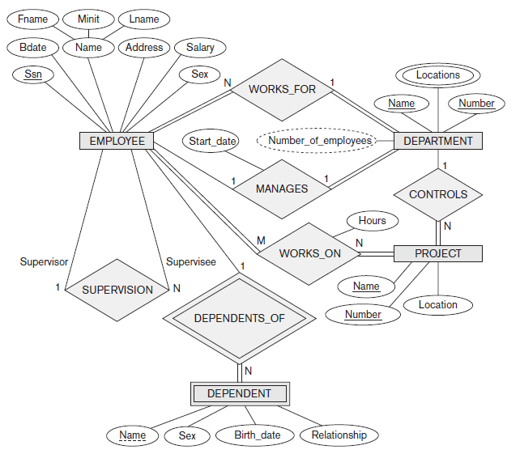
A Sample Database Application

